Slide 1
Sex chromosome translocations

Slide 2
X-inactivation
Transcriptional silencing
Facultative inactivation
Lyonization
Dosage compensation
Functional monosomy
Very early in embryonic development, X chromosome in every cell is randomly genetically inactivated
In all descendent progeny cells, same X chromosome remain inactive

Slide 3
Transcriptional silencing is initiated at an X-inactivation center (XIC) in Xq13
Within XIC is a gene XIST (X inactive specific transcript) that is cis-acting, transcribed only from the inactivated X
XIST produces no protein, just RNA that “coats” the X chromatin
Normal women can have skewed X inactivation
The inactive X replicates late during cell cycle
An obligate recombination event occurs in the PAR1

Slide 4
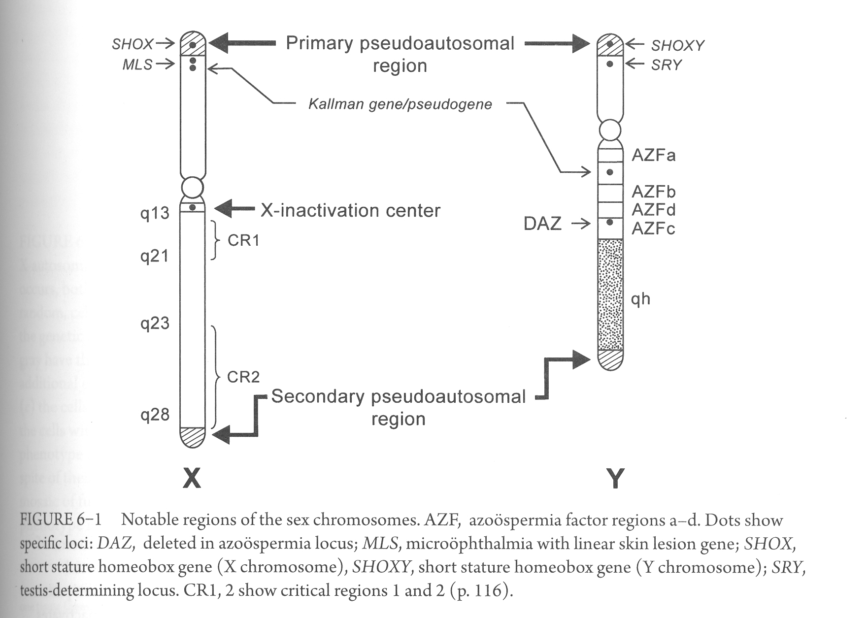

Slide 5
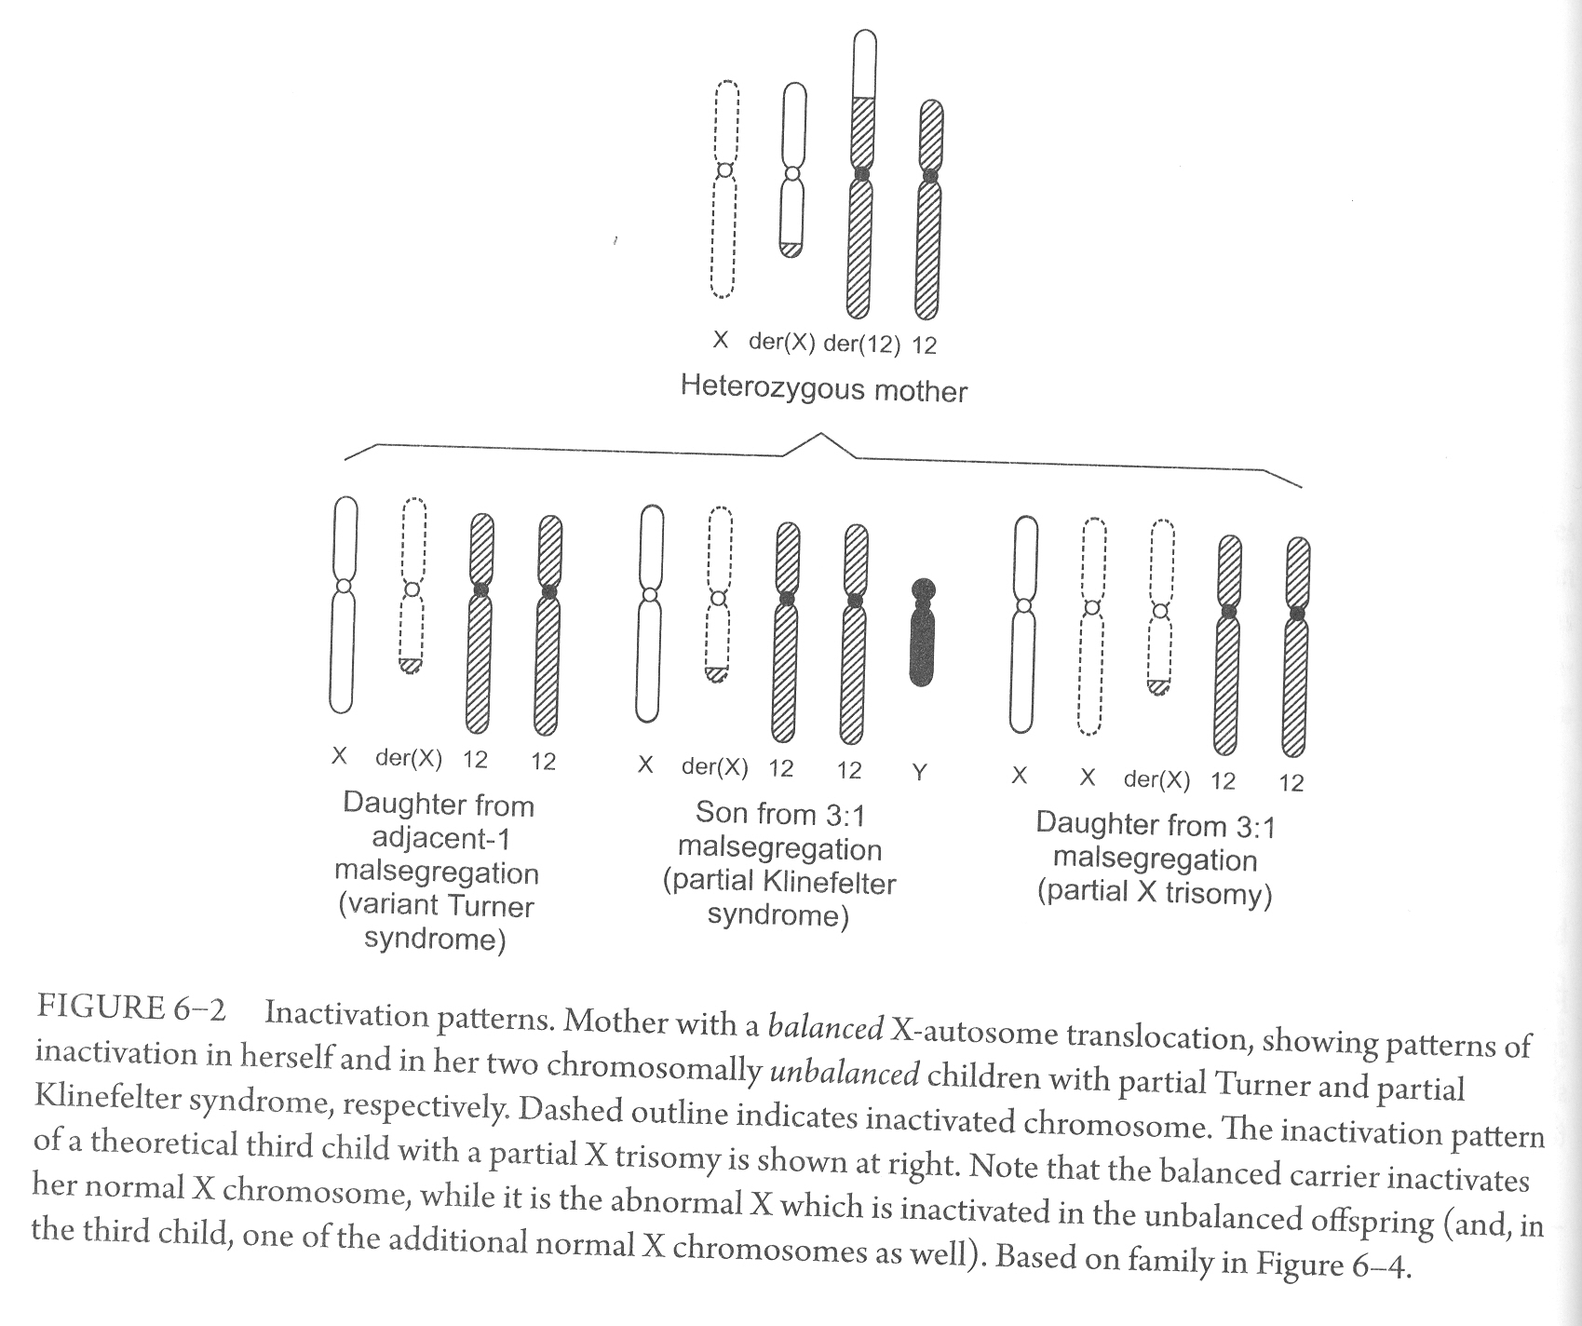
Female X-autosomal heterozygote

Slide 6
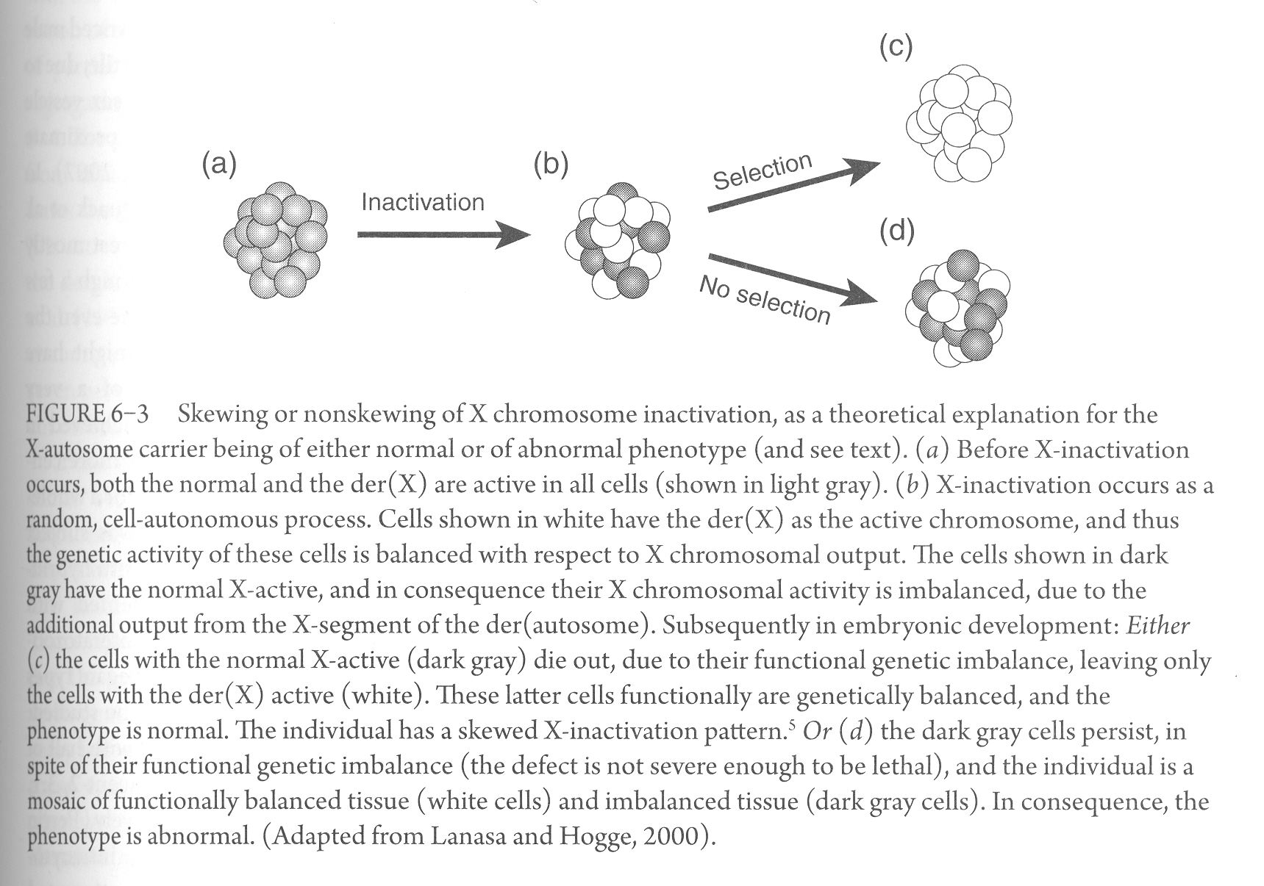
Normal phenotype
Abnormal phenotype

Slide 7
Measuring inactivation status
Assessed either cytogenetically (replication banding) which differentiates between early replicating (active) and late replicating (inactive) X chromosome
Or using molecular methodologies mostly by testing methylation of androgen receptor locus
X-inactivation might differ by tissue

Slide 8
Breakage and reunion within critical regions (CR1/POF2 and CR2/POF1) is associated with premature ovarian failure
Most of the time male X-autosomal hemizygote is infertile due to spermatogenic arrest

Slide 9
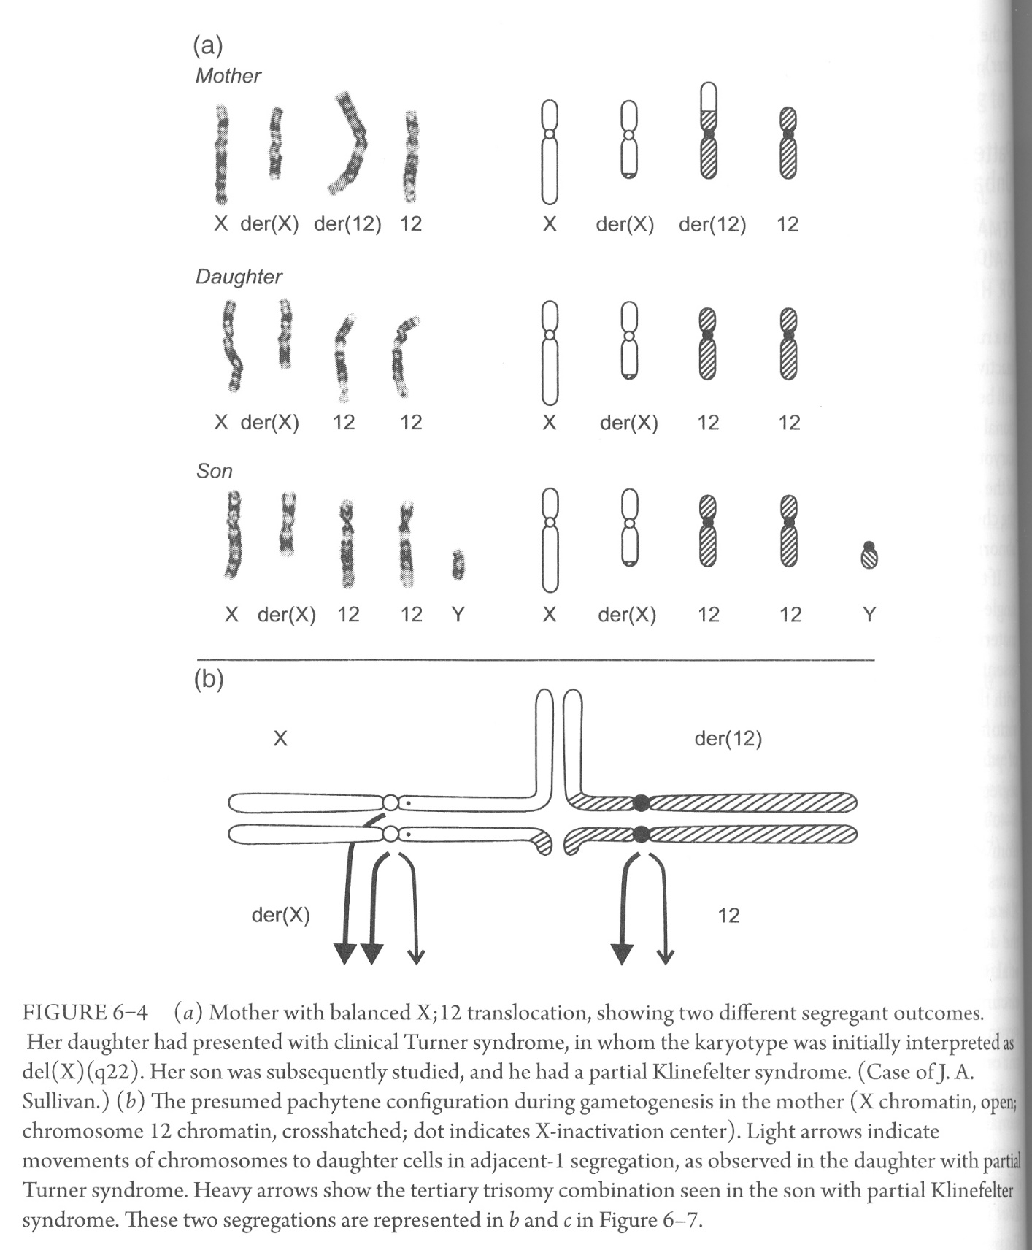
Patterns of inactivation in the unbalanced offspring
Female offspring of the X-autosomal heterozygote
The pattern of inactivation observed, following selection, will be the one that allows the least amount of functional imbalance
Typically the unbalanced daughter inactivates the abnormal chromosome

Slide 10
If der(X) carries a larger translocated autosomal segment – conferring a partial autosomal trisomy, effect of this imbalance will be mitigated by selective inactivation of the abnormal chromosome
Inactivation will spread , at least partially, on the autosomal segment, reducing the trisomy effect

Slide 11
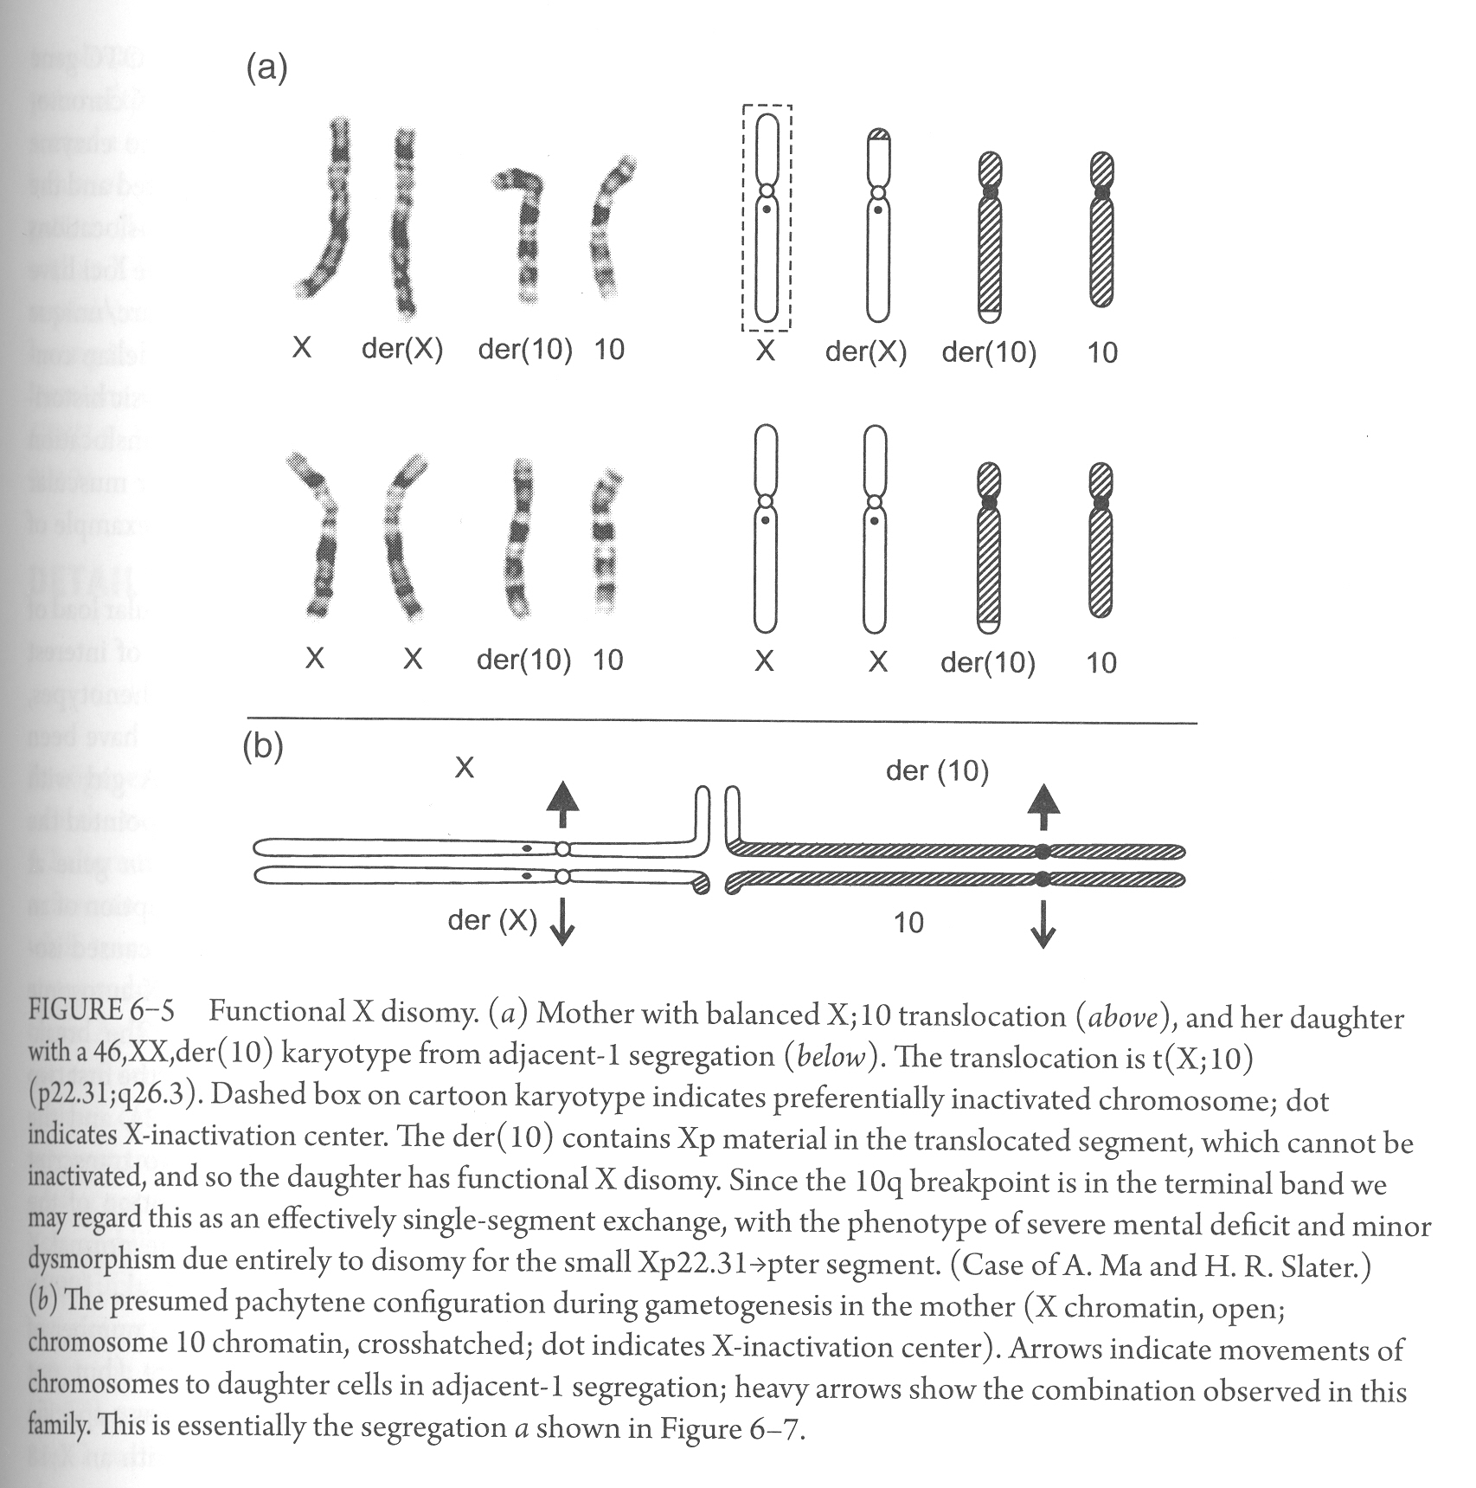
Functional disomy for part of the X chromosome that does not contain XIC

Slide 12
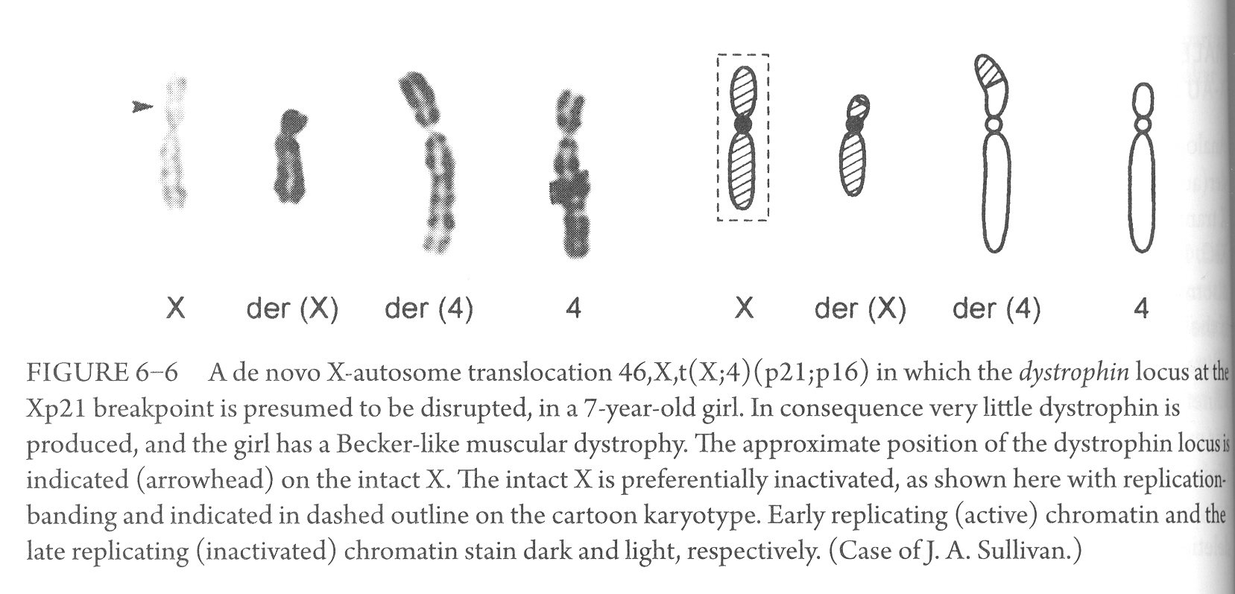
The de novo apparently balanced X-autosome translocation in the female provided the door to discovery of the chromosomal location of some X-linked disorders
Many disease loci were mapped by studying rare female patients with a particular Mendelian disease

Slide 13
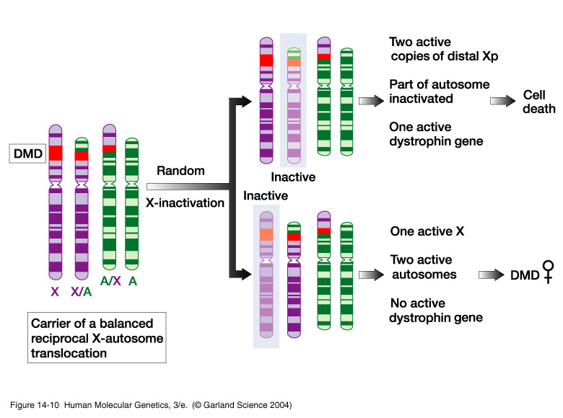
Nonrandom X inactivation occurs in female DMD patients with Xp21-autosome translocations
Notes:
14_10.jpg

Slide 14
Male offspring of the female X-autosome heterozygote
In the male, if the X-segment lacks an XIC, a functional X disomy results, with a severe phenotypic effect
If the X-segment contains an XIC, the X segment is inactivated and a Klinefelter-like phenotype might result
Origin of the X-autosome translocation. All de novo balanced X-autosomal translocations have been of paternal origin, reflecting the availability of the X chromosome for exchange with other chromosomes during male meiosis
The X pairs with the Y only at the PAR1, and the rest of the chromosome is unsynapsed

Slide 15
Details of meiotic behavior
Female meiosis
Given the greater survivability of X imbalances due to inactivation, and a possible lessened effect of autosomal imbalance, a greater number of conceptuses are potentially viable than from the autosome-autosome translocation

Slide 16
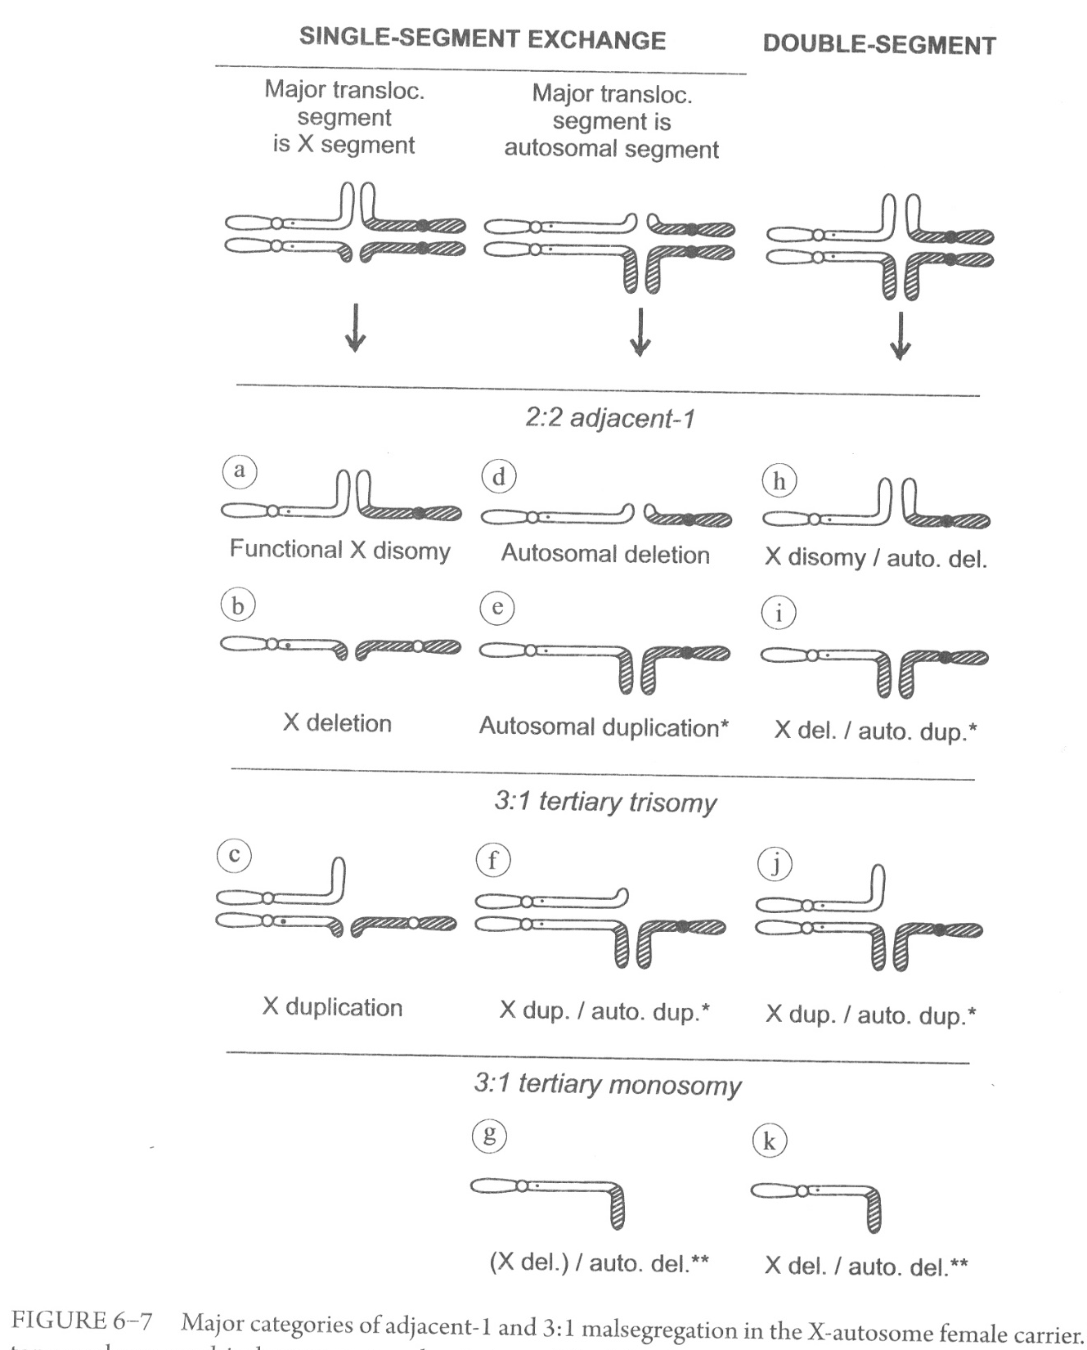
Female meiosis
Categories of translocation and modes of malsegregation
Single-segment exchange,
- X translocated segment
- autosomal translocated segment
Double-segment exchange, - adjacent-1
- adjacent-2
- 3:1 segregation with tertiary monosomy

Slide 17
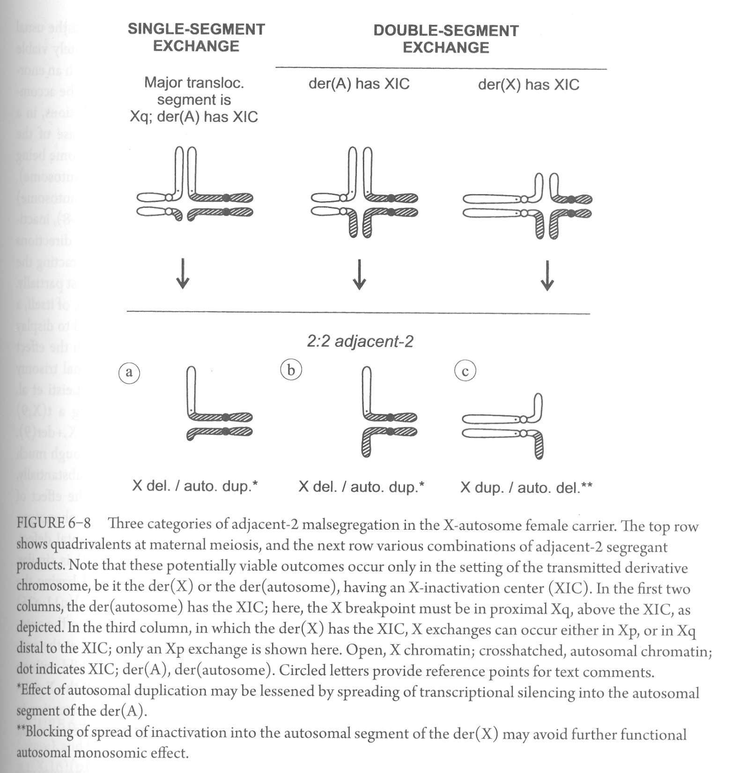

Slide 18
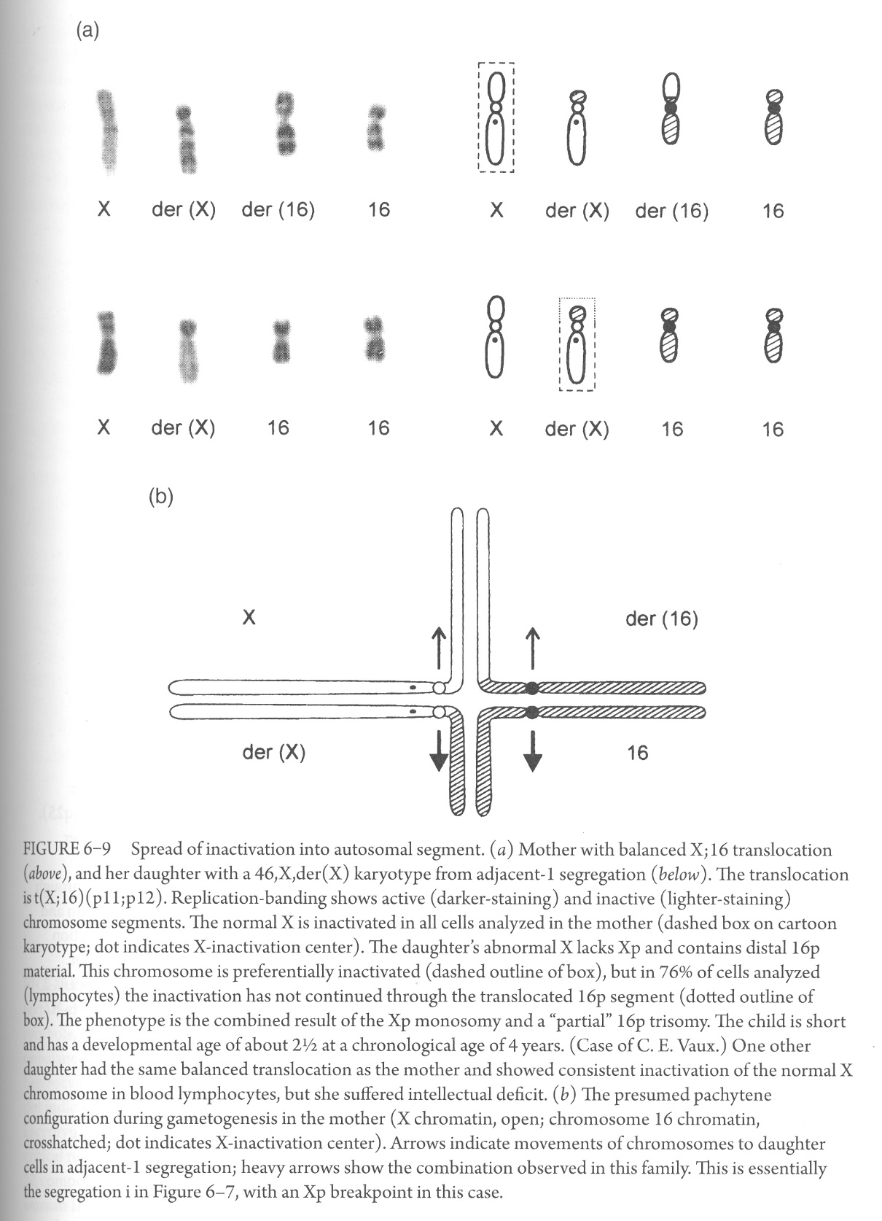
Example of double-segment exchange, adjacent-1
Spread of inactivation into the autosomal segment will lessen the effect of trisomy
Changing it from structural trisomy into (partial) functional disomy
abort

Slide 19
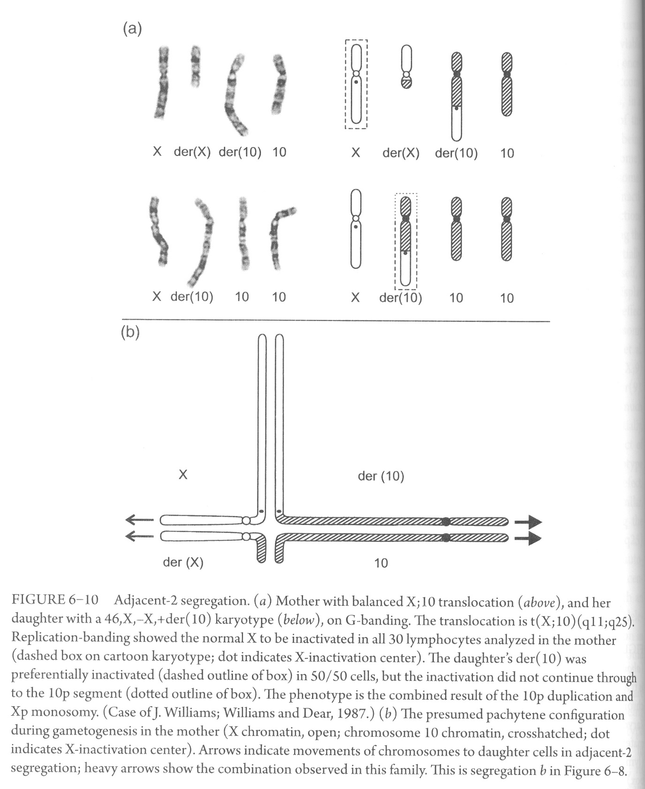
Example of double-segment exchange, adjacent-2
Spread of inactivation was interrupted at the short arm of the autosomal chromosome
Phenotype is the combined result of the 10p duplication and Xp monosomy

Slide 20
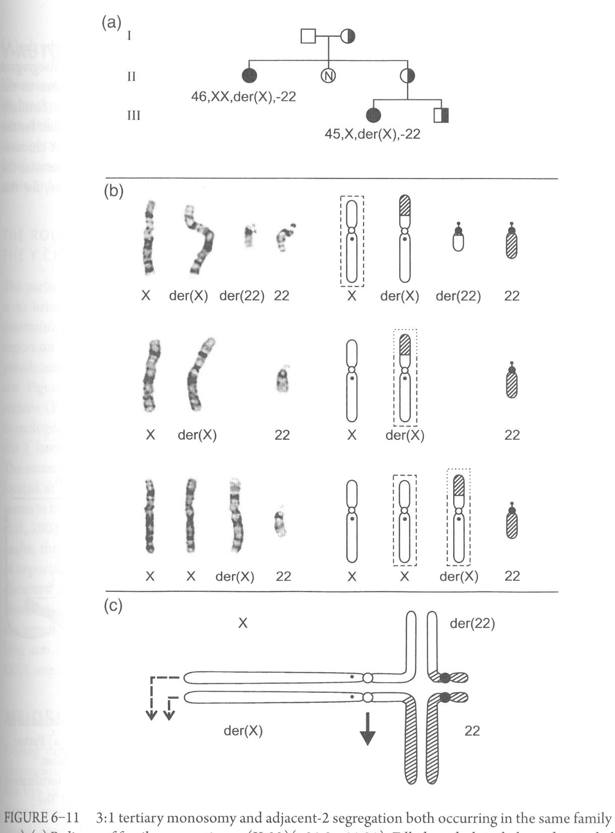
Another example of double-segment exchange, adjacent-2
Some instances an intact X and the der(X) will be transmitted together:
46,XX,-(autosome),+der(X)
The autosomal segment must contain the majority of the chromosome, with little or no spread of inactivation on the autosomal segment
3:1 tertiary monosomy
Intellectual disability & congenital anomalies
Mild intellectual disability

Slide 21
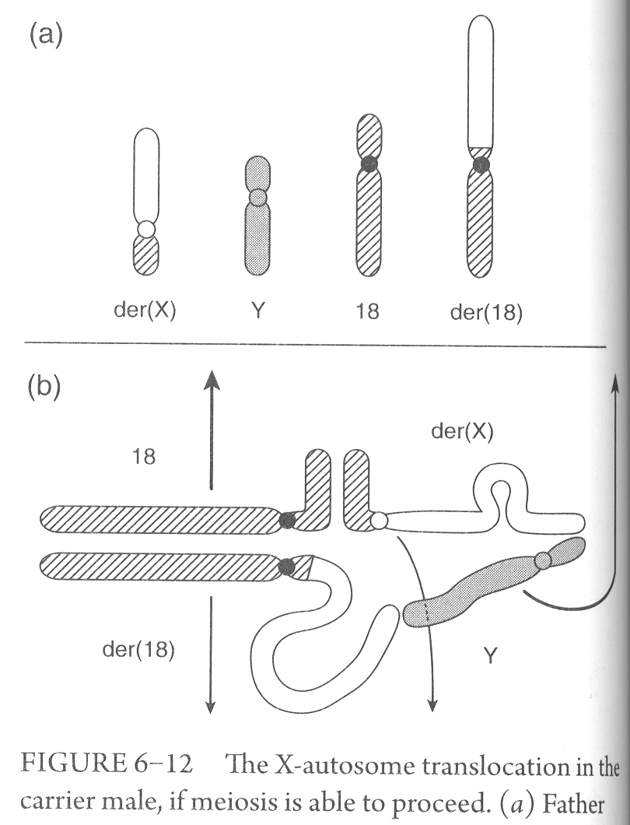
Male meiosis
Meiosis in the X-autosome hemizygote is typically compromised
Infrequently, some sperm may be made

Slide 22
Y-autosome translocations
The major function of the Y chromosome is bring about male development
SRY gene, PAR1, PAR2, azoospermia factor regions
Euchromatic region, heterochromatic region (repetitive DNA)
Meiosis
The X and Y synapsed at PAR1 comprise the “sex vesicle” (or sex-body, or XY-body)
A properly formed sex vesicle is necessary for normal spermatogenesis

Slide 23
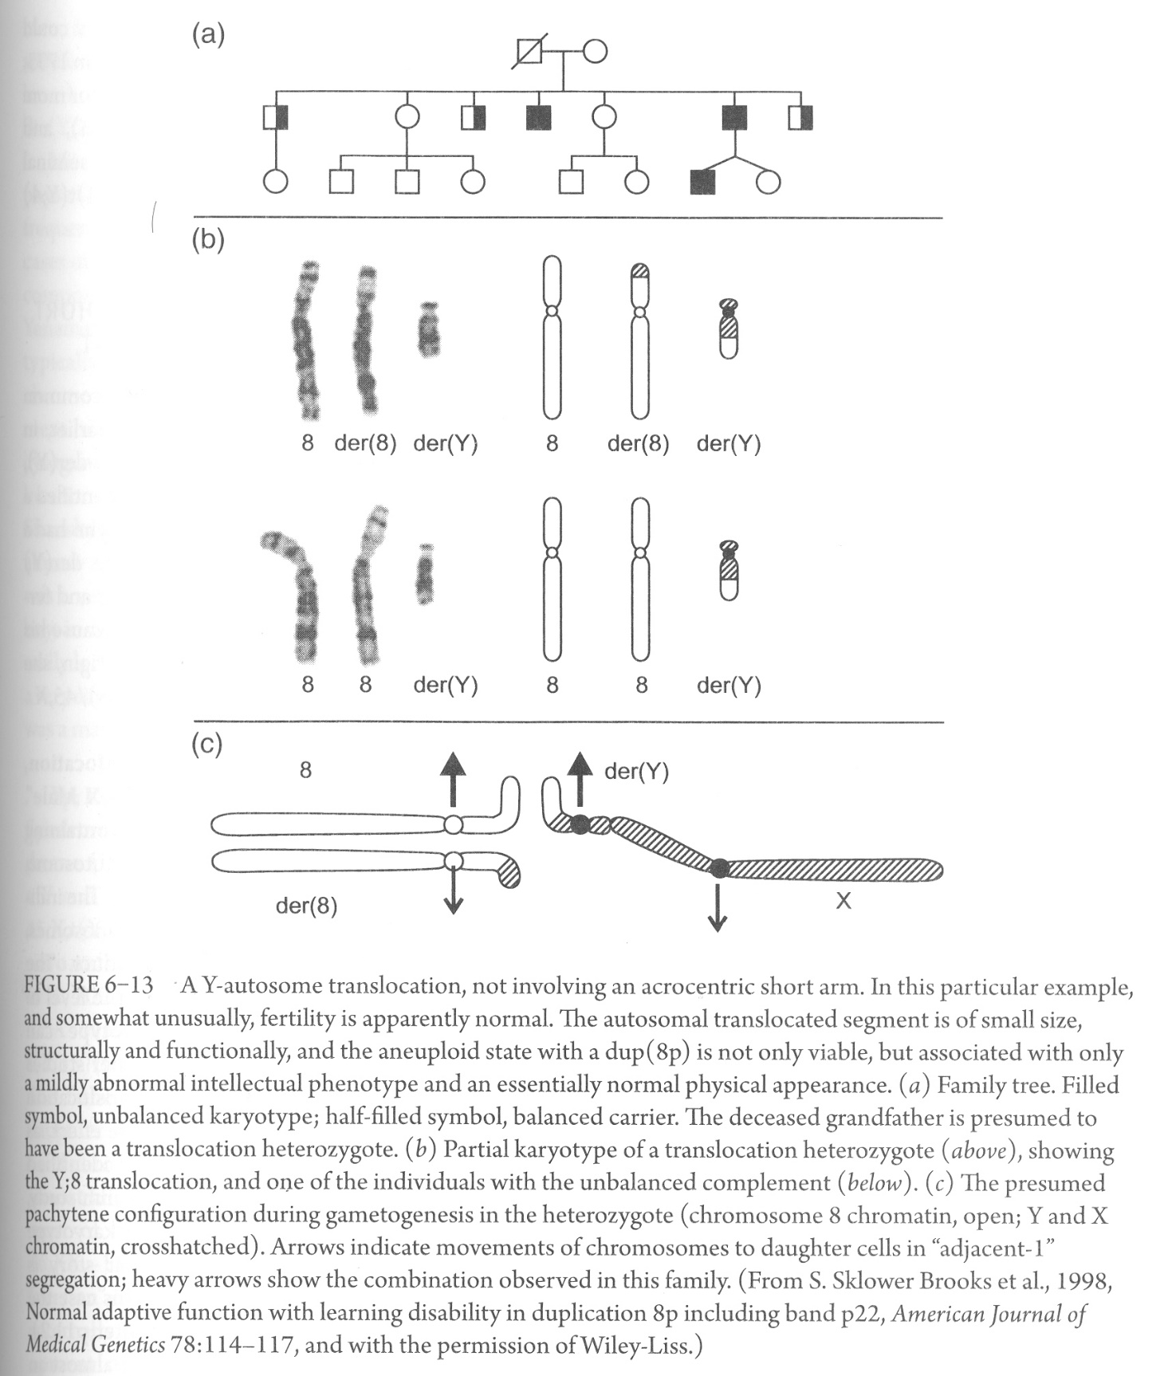
Infertility is the usual presenting factor in Y-autosome translocation
Sometimes fertility is intact
In this example, only some learning difficulty is observed due to partial chr 8 trisomy

Slide 24
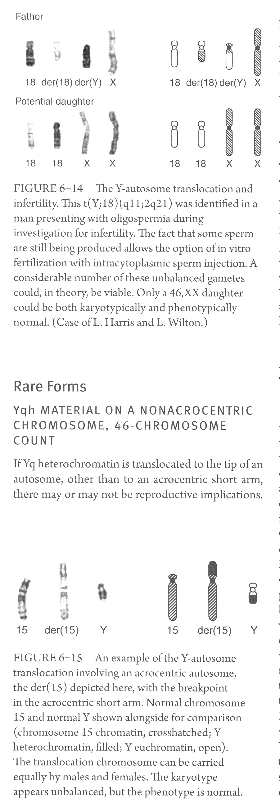

Slide 25
Y long-arm and acrocentric short-arm translocations
The most common form of Y-autosome translocation, accounting for ~70% of cases
No loss or gain of euchromatin. Extra phenotypically irrelevant Y heterochromatin

Slide 26
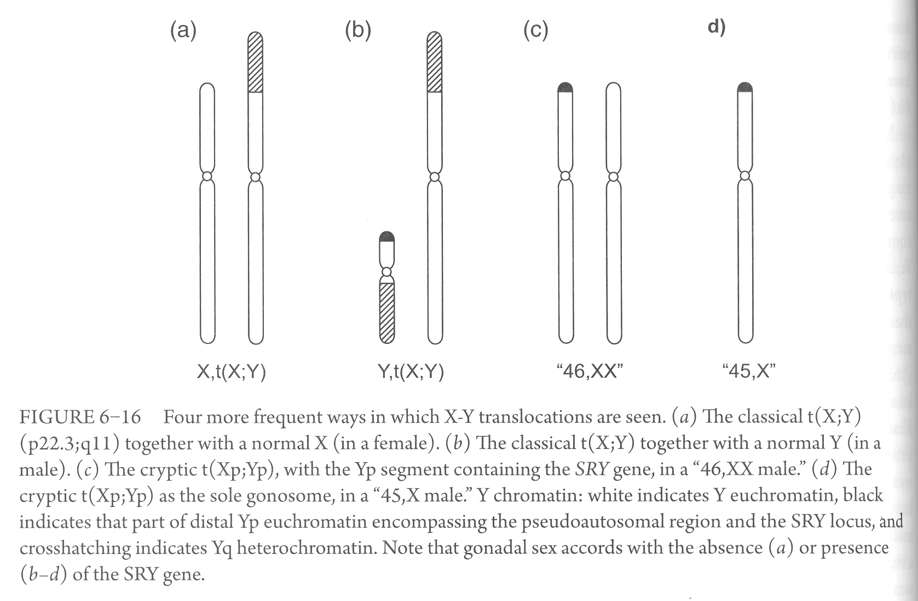
Monosomic
Fertile
Nullisomic
Infertile
Infertile
Infertile
X-Y translocations
SHOX gene: Leri-Weill dyschondrosteosis

